Slide 1


Hotel Aggregator Analysis
Presented By:
Akash Jyoti Saikia

Slide 2
INTRODUCTION
This project aims to analyze a hotel aggregator dataset using Power BI to uncover trends and patterns. The goal is to create visualizations highlighting key metrics such as pricing trends, availability rates, host characteristics, and review scores. The objective is to derive actionable insights to improve the quality and competitiveness of the listings, helping stakeholders optimize pricing strategies, host practices, and guest experiences.
The dataset includes attributes such as:
Listings: Location, type, price, and amenities.
Hosts: Response rates, number of listings, and experience levels.
Reviews: Customer feedback and review scores.
Availability: Year-round availability data, showing occupancy trends and peak seasons.
This data enables a comprehensive analysis to enhance listing performance and platform offerings.

Slide 3
OBJECTIVES
Key Metrics:
Pricing: Analyze price trends to understand seasonal variations and their impact on occupancy.
Availability: Examine availability data to identify peak seasons and periods of low occupancy.
Host Characteristics: Investigate host data such as response rates, number of listings, and experience to determine their influence on listing performance.
Review Scores: Assess customer feedback and review scores to gauge guest satisfaction and identify areas for improvement.
Goals:
Identify Trends: Uncover seasonal and long-term trends in pricing and occupancy.
Analyze Patterns: Detect patterns in host behavior and their impact on listing success.
Determine Influencing Factors: Identify key factors that influence listing performance, such as pricing strategies, host practices, and guest reviews.
Provide Recommendations: Offer data-driven insights to optimize pricing, improve host practices, and enhance guest experiences, ultimately improving the quality and competitiveness of the listings.

Slide 4
METHODOLOGY
Data Analysis Tools:
Power BI: Main tool for analysis and visualization.
Microsoft Excel: Used for initial data cleaning.
Approach:
Data Collection: Obtained dataset from the given links.
Data Cleaning: Removed duplicates and handled missing values.
Data Transformation: Aggregated and calculated new metrics.
Exploratory Data Analysis: Identified key patterns and anomalies.
Visualization: Developed interactive dashboards in Power BI.
Insight Generation: Analyzed visualizations to derive actionable insights.

Slide 5
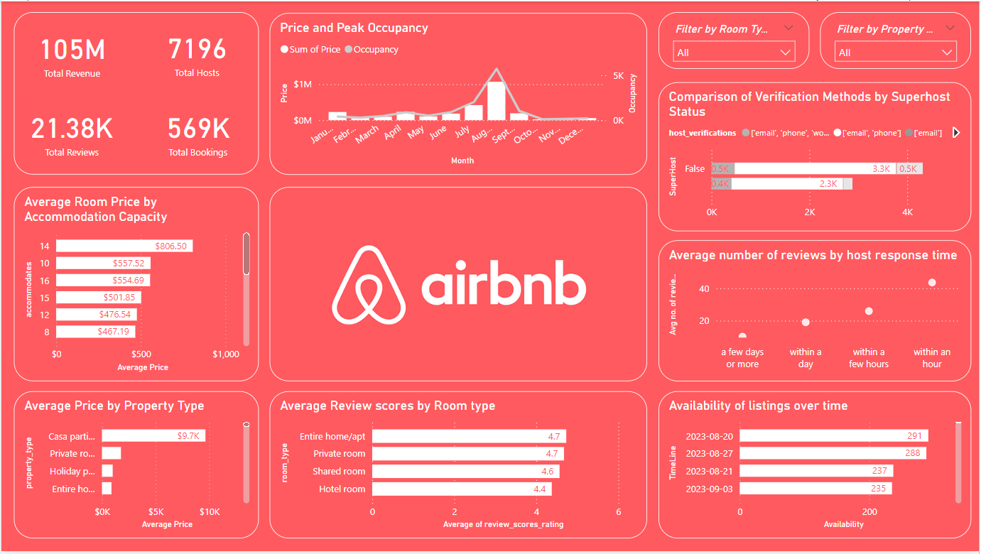
FINAL DASHBOARD

Slide 6

INSIGHTS
Casa particular properties have an average booking price of $9.7k USD but have not recorded any bookings over the years.
Hosts responding within an hour have generated the highest revenue compared to other response time categories, totaling $488k USD from 5,062 hosts.
August witnesses the highest number of bookings annually, with a peak of 5,722 bookings, generating the highest revenue of $60.39M USD.
Entire home/apartment room types contribute the highest revenue of $97M USD, whereas shared rooms generate only $142k USD, indicating a disparity in revenue generation despite the smaller number of hosts offering shared rooms.

Slide 7


RECOMMENDATION
HOSTS
PLATFORMS

Slide 8
Hosts should prioritize responding to inquiries within an hour to maximize revenue, as demonstrated by the higher revenue generated by hosts with quick response times.
HOSTS
Consider diversifying property offerings beyond casa particular type to attract a wider range of guests and increase booking opportunities.
Capitalize on the peak booking period in August by offering promotions or special deals to attract more guests during this time.
Hosts offering shared rooms should focus on enhancing the quality and appeal of these listings to increase revenue, despite the smaller number of hosts in this category.

Slide 9
Implement incentives or rewards for hosts who maintain quick response times to encourage responsiveness and improve guest satisfaction.
PLATFORMS
Highlight and promote diverse property types, including casa particular, to cater to different guest preferences and increase booking diversity.
Enhance the booking experience during peak periods, such as August, by ensuring platform stability, offering relevant recommendations, and facilitating seamless transactions.
Provide hosts with data-driven insights and recommendations based on booking trends and guest preferences to help them optimize pricing strategies and improve listing performance.

Slide 10
CONCLUSION
The analysis has provided valuable insights into booking trends, host responsiveness, and revenue generation patterns within the hotel aggregator platform.
Leveraging these insights, stakeholders can optimize pricing strategies, prioritize responsiveness, and tailor offerings to maximize revenue and enhance guest satisfaction.
This data-driven approach ensures a competitive edge in the dynamic hospitality industry, fostering continuous improvement and adaptability to evolving market demands.

Slide 11

THANK YOU

